Slide 1

Chapter 7
Filesystems

Slide 2

Superblocks
Everything begins with a 'superblock’
file system type
disk geometry (size/status)
available space
location of the first inode
There are multiple redundant copies of the superblock

Slide 3
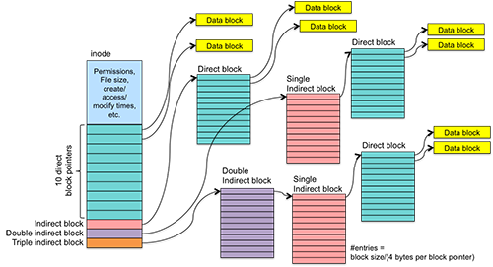

File System Structure (inodes and data blocks)

Slide 4
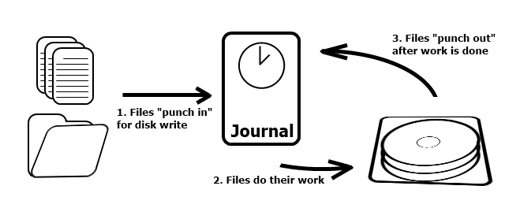
Journaling file system

Slide 5

ext3 (2001)
The main benefit of ext3 is that it allows journaling.
There are three types of journaling available in ext3 file system.
Journal – Metadata and content are saved in the journal.
Ordered – Only metadata is saved in the journal. Metadata are journaled only after writing the content to disk. This is the default.
Writeback – Only metadata is saved in the journal. Metadata might be journaled either before or after the content is written to the disk.
You can convert a ext2 file system to ext3 file system directly (without backup/restore)
Maximum individual file size can be from 16 GB to 2 TB
Overall ext3 file system size can be from 2 TB to 32 TB

Slide 6

ext4 (2008)
You can mount existing ext3 fs as ext4 (without upgrading)
New features in ext4: multiblock allocation, delayed allocation, journal checksum, fast fsck, etc.
All you need to know is that these new features have improved the performance and reliability of the filesystem when compared to ext3
Maximum individual file size: 16 GB to 16 TB
Overall maximum file system size: 1 EB (exabyte) Directory can contain a maximum of 64,000 subdirectories (as opposed to 32,000 in ext3)
Option to turn journaling “off”

Slide 7
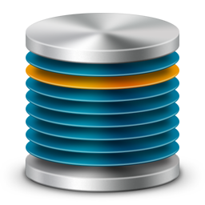
btrfs (butter fs)
B-tree file system
All the features of ext4 plus:
Built-in RAID (mirroring and striping)
Online defragmentation
Support for snapshots and sub-volumes
Online adding and removing volumes
Designed for enterprise scalability

Slide 8


xfs
“Big Iron” file system
File systems up to 9 exabytes (9 million terabytes!!)
File size up to 9 exabytes
Support for extended attributes
Online defrag and resizing
Performance close to hardware speed
Proven enterprise performance and scaling

Slide 9
Physical Disks and Partitions
Device names follow standards:
/dev/sda1 or /dev/hdb3
s = scsi h = ide (old school)
a = first physical disk b = second physical disk
1 = first logical partition 3 = third logical partition

Slide 10
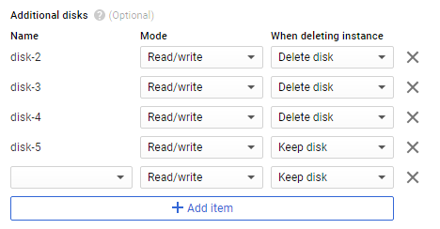
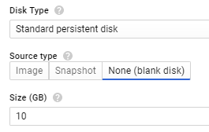
Add disks to GCP instance
Click on your machine name
Click EDIT on the VM instance details page
Under Additional disks click Add item
Create a 10Gb blank disk (x4)
Don’t forget to save!

Slide 11
listing block devices
lsblk (list block devices)
NAME MAJ:MIN RM SIZE RO TYPE MOUNTPOINT
sdd 8:48 0 10G 0 disk sdb 8:16 0 10G 0 disk sde 8:64 0 10G 0 disk sdc 8:32 0 10G 0 disk sda 8:0 0 10G 0 disk └─sda1 8:1 0 10G 0 part /

Slide 12
sudo gdisk –l /dev/sde
GPT fdisk (gdisk) version 1.0.1
Partition table scan:
MBR: not present BSD: not present APM: not present GPT: not present
Creating new GPT entries. Disk /dev/sde: 20971520 sectors, 10.0 GiB Logical sector size: 512 bytes Disk identifier (GUID): EA2575B5-2D32-4BF7-B3B3-6C43B6A75309 Partition table holds up to 128 entries First usable sector is 34, last usable sector is 20971486 Partitions will be aligned on 2048-sector boundaries Total free space is 20971453 sectors (10.0 GiB)
Number Start (sector) End (sector) Size Code Name

Slide 13
gdisk
b back up GPT data to a file
c change a partition's name
d delete a partition
i show detailed information on a partition
l list known partition types
n add a new partition
o create a new empty GUID partition table (GPT)
p print the partition table
q quit without saving changes
r recovery and transformation options (experts only)
s sort partitions
t change a partition's type code
v verify disk
w write table to disk and exit
x extra functionality (experts only)
? print this menu

Slide 14
mkfs
mkfs is the same as formatting a drive in Windows
You select the type of filesystem you want (EXT2, EXT4, FAT, EXT3)
mkfs -t [type] [device]
examples:
$ sudo mkfs -t ext2 /dev/sdb1 $ sudo mkfs -t msdos /dev/sdb2 $ sudo mkfs –t ext4 /dev/sdc1

Slide 15
mount
The partition must be 'mounted' into the filesystem for the system or users to access it
You use an empty directory (called a 'mount point')
The mount command with no options will show all mounted filesystems

Slide 16
mount
mount [options] [devicename] [mountpoint]
example:
$ sudo mkdir /media/msdos $ sudo mount -t msdos /dev/sdb2 /media/msdos $ mount /dev/sdb2 on /media/msdos type vfat (rw)
$ sudo umount /media/ext2
** NOTE: the command is umount and not unmount **

Slide 17
/etc/fstab
DEVICE MOUNT POINT FILESYSTEM OPTIONS
LABEL=cloudimg-rootfs / ext4 defaults 0 0
192.168.1.245:/var/cety-scripts/cet2331/cet2331 /scripts-2331 nfs defaults 0 0

Slide 18

Order of Operations
Add the new disk.
Partition the disk using gdisk.
Format the disk with the appropriate filesystem.
Create a mount point using mkdir.
Mount the disk to the mount point using mount.
Add the disk information in /etc/fstab to re-mount on reboot.

